Slide 1


Chapter 1
Introduction: Computer and Network Security
//Modified by Prof. M. Singhal//
Henric Johnson
Blekinge Institute of Technology, Sweden
www.its.bth.se/staff/hjo/
henric.johnson@bth.se
+46 708 250375

Slide 2
Outline
Information security
Attacks, services and mechanisms
Security attacks
Security services
Methods of Defense
A model for Internetwork Security
Internet standards and RFCs

Slide 3
Information Security
“Protection of data”.
Has gone two major changes:
1. Computer Security:
oTimesharing systems: multiple users share
the H/W and S/W resources on a computer.
o Remote login is allowed over phone lines.
“Measures and tools to protect data and thwart
hackers is called Computer Security”.

Slide 4
Information Security…
2. Network Security:
Computer networks are widely used to connect computers at distant locations.
Raises additional security problems:
o Data in transmission must be protected.
o Network connectivity exposes each computer to more vulnerabilities.

Slide 5
Attacks, Services and Mechanisms
Three aspects of Information Security:
Security Attack: Any action that compromises the security of information.
Security Mechanism: A mechanism that is designed to detect, prevent, or recover from a security attack.
Security Service: A service that enhances the security of data processing systems and information transfers. A security service makes use of one or more security mechanisms.

Slide 6
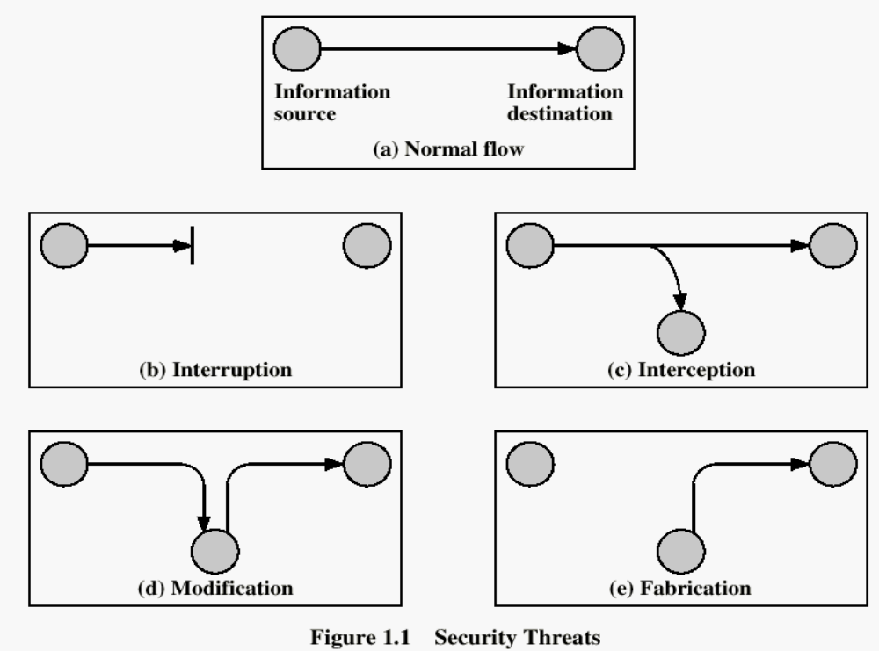
Security Attacks

Slide 7
Security Attacks
Interruption: An asset of the system is destroyed or becomes unavailable or unusable.
This is an attack on availability.
Examples:
Destroying some H/W (disk or wire).
Disabling file system.
Swamping a computer with jobs or communication link with packets.

Slide 8
Security Attacks
Interception: An unauthorized party gains access to an asset.
O This is an attack on confidentiality.
Examples:
>Wiretapping to capture data in a network.
>Illicitly copying data or programs.

Slide 9
Security Attacks
Modification: An unauthorized party gains access and tampers an asset.
oThis is an attack on integrity.
Examples:
Changing data files.
Altering a program.
Altering the contents of a message.

Slide 10
Security Attacks
Fabrication: An unauthorized party inserts a counterfeit object into the system.
O This is an attack on authenticity.
Examples:
> Insertion of records in data files.
> Insertion of spurious messages in a network. (message replay).

Slide 11
Passive vs. Active Attacks
1. Passive Attacks:
o Eavesdropping on information without
modifying it.
(difficult to detect ).
2. Active Attacks:
o Involve modification or creation of info.

Slide 12
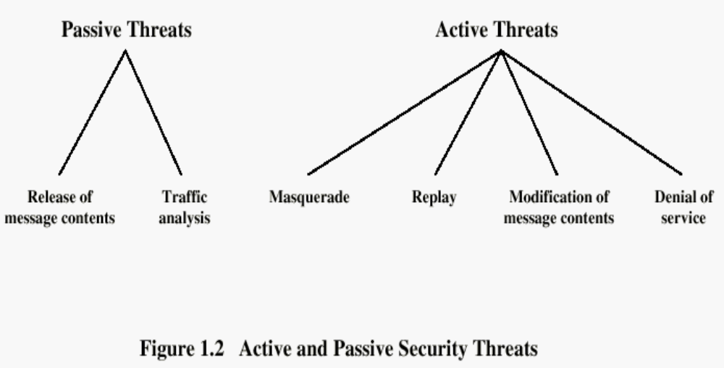

Slide 13
Passive Threats
Release of a message contents:
Contents of a message are read.
> A message may be carrying sensitive or confidential data.
Traffic analysis:
An intruder makes inferences by observing message patterns.
> Can be done even if messages are encrypted.
> Inferences: location and identity of hosts.

Slide 14
Active Threats
Masquerade:
An entity pretends to be some other entity.
Example: An entity captures an authentication sequence and replays it later to impersonate the original entity.
Replay:
Involves capture of a data unit and its retransmission to produce an unauthorized effect.

Slide 15
Active Threats
Modification of messages:
A portion of a legitimate message has been altered to produce an undesirable effect.
Denial of service:
Inhibits normal use of computer and communications resources.
> Flooding of computer network.
>Swamping of CPU or a server.

Slide 16
Security Services
A classification of security services:
Confidentiality (privacy)
Authentication (who created or sent the data)
Integrity (has not been altered)
Non-repudiation (the order is final)
Access control (prevent misuse of resources)
Availability (permanence, non-erasure)
  Denial of Service Attacks
  Virus that deletes files

Slide 17
Security Goals
Confidentiality
Integrity
Avalaibility

Slide 18
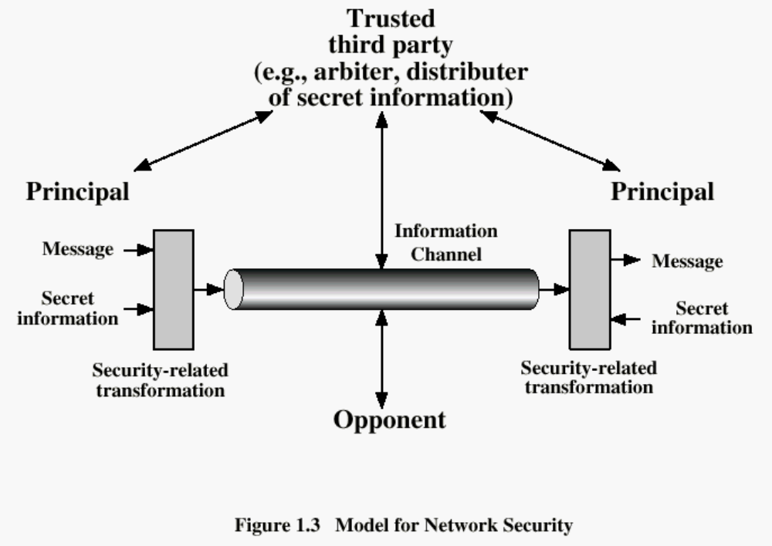

Slide 19
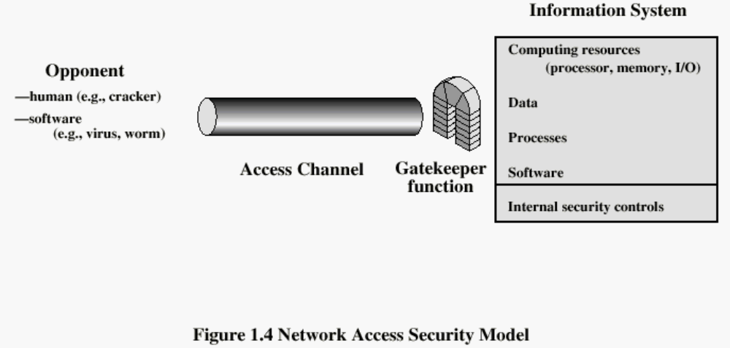

Slide 20
Methods of Defence
Encryption
Software Controls (access limitations in a data base, in operating system protect each user from other users)
Hardware Controls (smartcard)
Policies (frequent changes of passwords)
Physical Controls

Slide 21
Internet standards and RFCs
The Internet society
  Internet Architecture Board (IAB)
  Internet Engineering Task Force (IETF)
  Internet Engineering Steering Group (IESG)

Slide 22
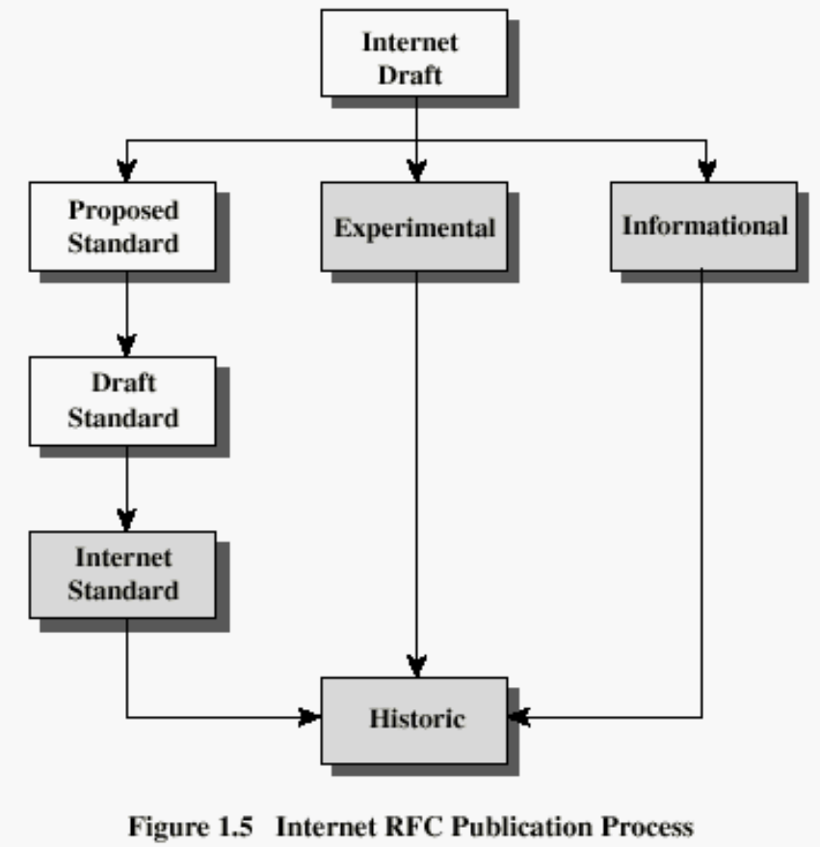
Internet RFC Publication Process

Slide 23
Recommended Reading
Pfleeger, C. Security in Computing. Prentice Hall, 1997.
Mel, H.X. Baker, D. Cryptography Decrypted. Addison Wesley, 2001.

